Slide 1
Easy Cabinet Maker
Version 13.5

Slide 2
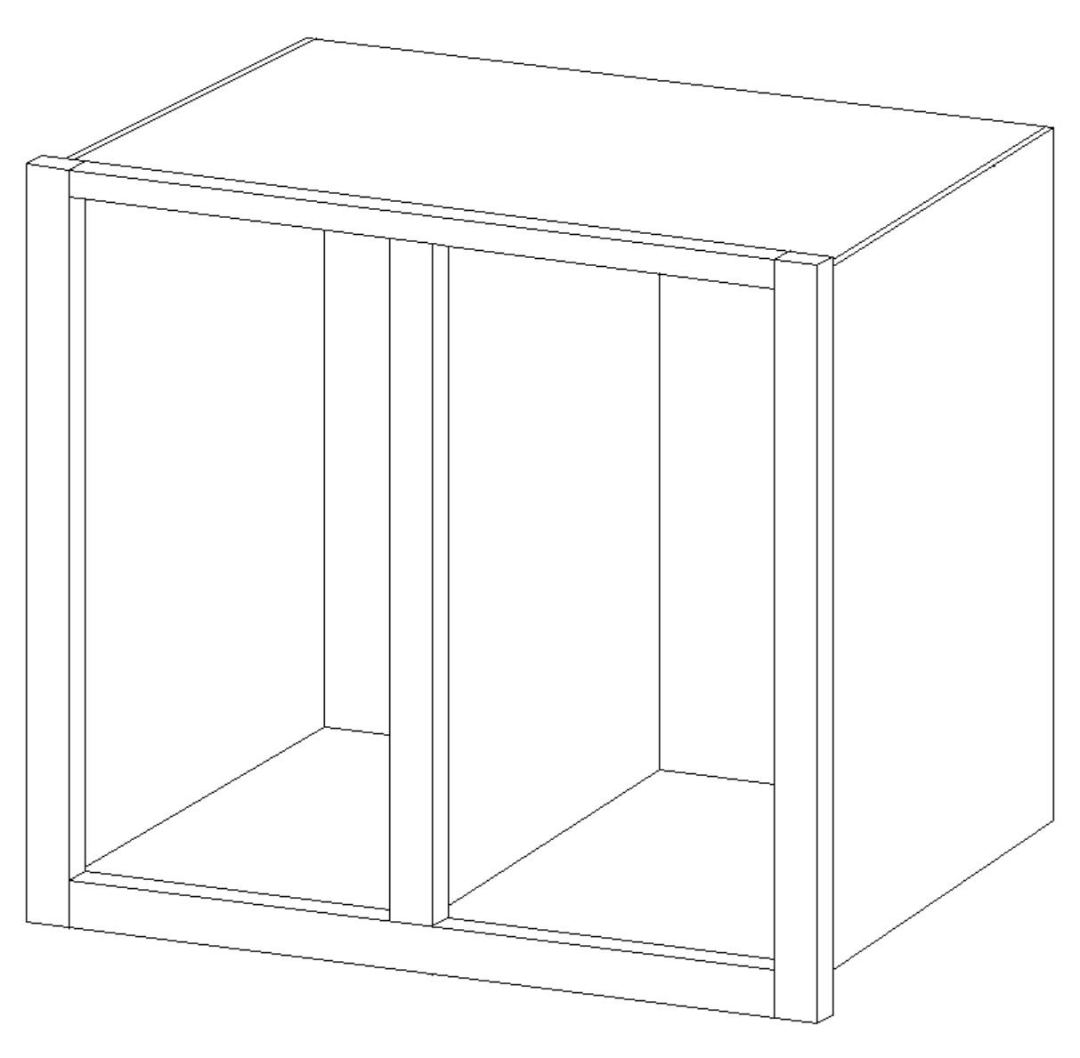
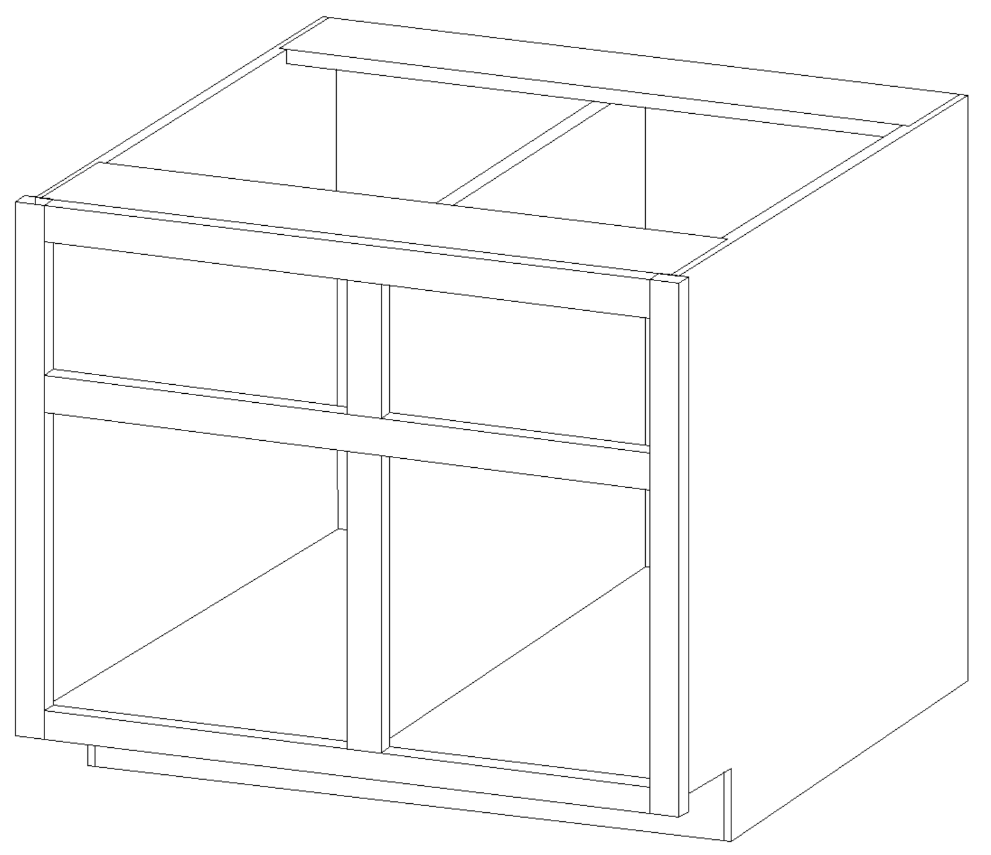
Gadget Overview
The Easy Cabinet maker gadget is a plug-in program for the Vectric Aspire or VCarve Pro Versions 11+ products.
The gadget produces a face frame style cabinet in the upper (wall) or lower (base) or both configuration. The program is designed on being 100% parametrically driven. This design allows the user to have complete control of all variables being defined by the user. The solution features :
Complete cabinet drawings with toolpaths
Two styles of Bill of Materials
Print ready shop cut list
Excel ready “.csv” file for material needs
Optional sheet layouts for variable material thicknesses
Face Frame layouts
Drawer Slide and Rear Mount pilot holes
Import and Export configuration capabilities
Supports imperial or metric input values
And many other features

Slide 3
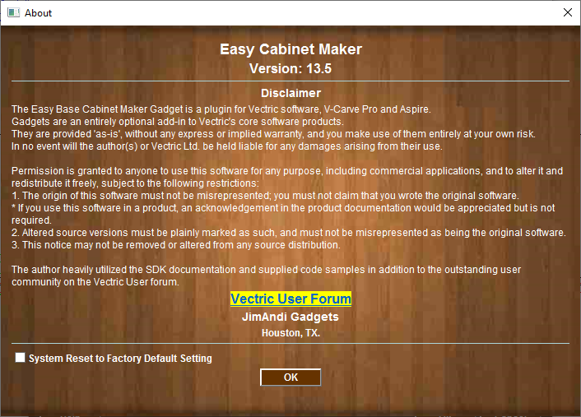
About Screen
Displays the Current Version
Please read and understand the Disclaimer
Reset all Cabinet Settings to Default Values
(Restarting Vectric program is Required)

Slide 4
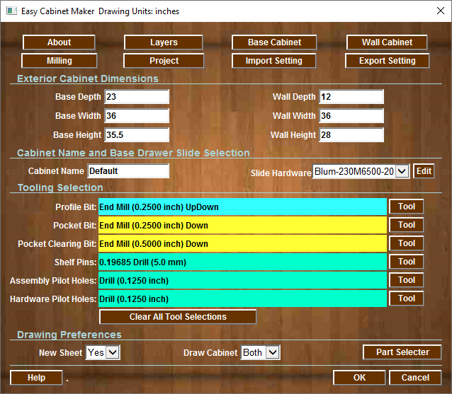
Main Screen
About Gadget
Wall Default Settings
Import & Export Settings
Base Cabinet Size
Wall Cabinet Size
Enter Cabinet Name (BOM)
Base Cabinet Drawer Slides Pilot Holes
Toolpaths will be added if you select tooling (tools are saved)
Clear Tool Selection
Add Sheets
Select the cabinet parts will be drawn
Select the Cabinet to be drawn (Base Wall or Both)

Slide 5
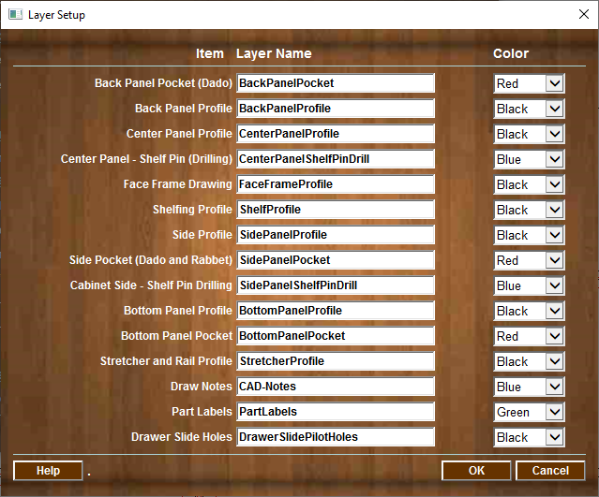
Layer Setup
Layer Colors
Layer Name for each Milling Operation

Slide 6
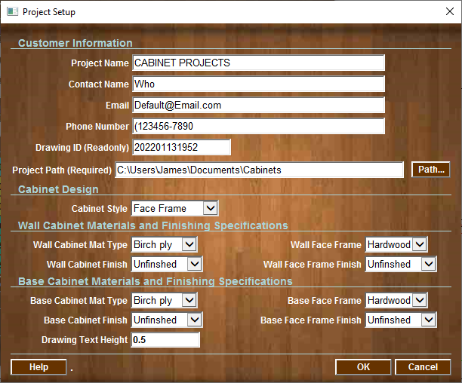
Project Setup
Project And Contact Information
Project Path is required. Location for all logs and BOM files to be written
Cabinet Style
(Face Frame or No Face Frame)
Select Material
Types and Finish's

Slide 7
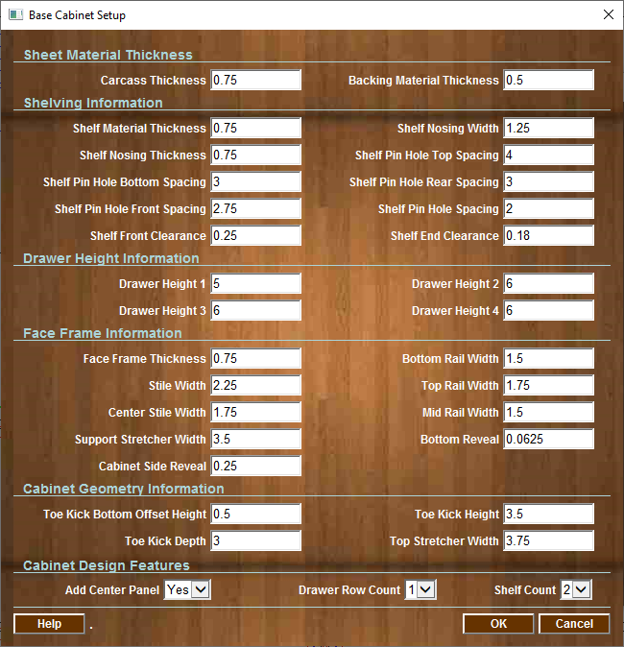
Base Cabinet Setup
Enter Material Thickness
Enter Shelving Settings
Drawer Heights
Base Cabinet Face Frame Values
Toe Kick and Stretcher values
Base Cabinet
Center Panel
Drawer and Shelf Counts

Slide 8
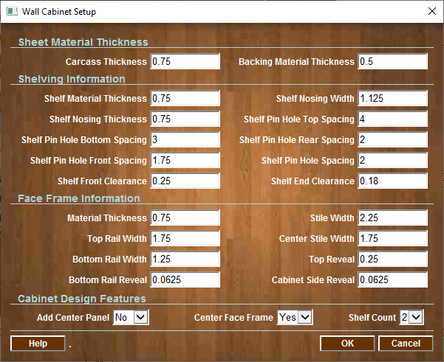
Wall Cabinet Setup
Enter Material Thickness
Shelf Values
Wall Cabinet Face Frame Values
Wall Cabinet
Center Panel
Number of Shelfs

Slide 9
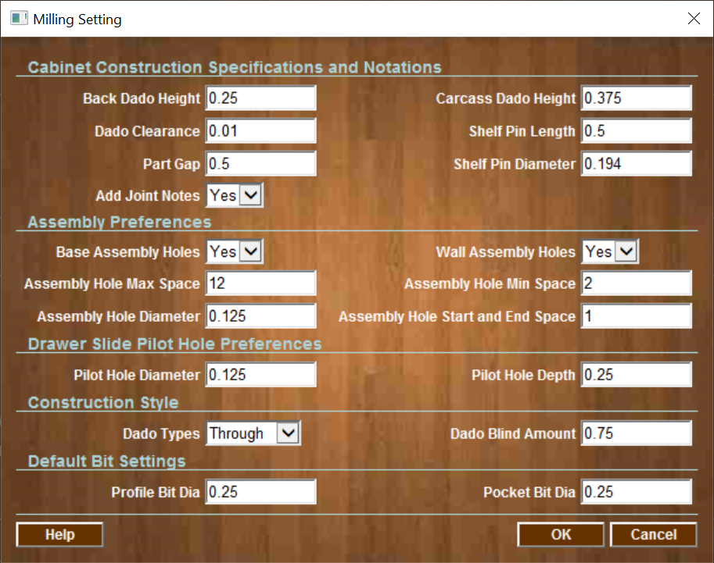
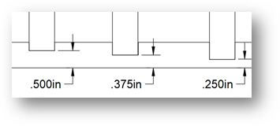
Milling Settings Menu
Default values for Milling
Assembly Holes and Placement
Drawer Slide Pilot Holes Details
Milling Types
Default Bit Diameter
Note: Back Dado Height and Dado Height are measurements from the material back to the bottom of the Dado. Sheet goods very in thickness, a 3/4” plywood is never 3/4” it is usually 23/32” thick or less. This will ensure the overall dimensions of the cabinet will be accurate regardless of thickness of the material being used.
Material Back or Bottom
Dado Height Amount Value

Slide 10
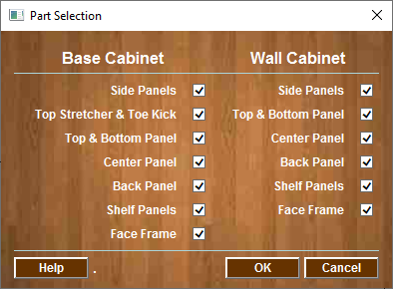
Part Selection Menu
Select which parts to be displayed on the drawing

Slide 11
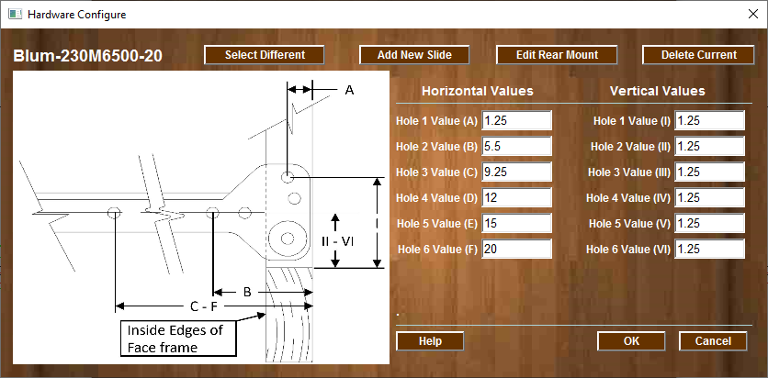
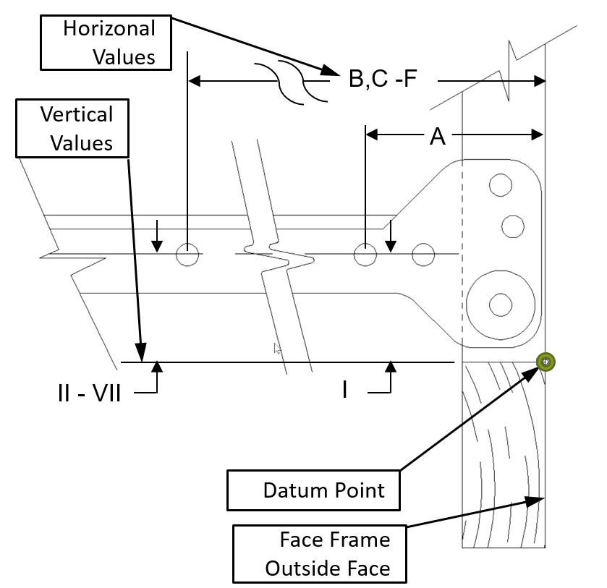
Slide Mount Menu
Select Different Drawer Slide
Add New Drawer Slide
Edit the Rear Mount Data
Delete Current Drawer Slide
Drawer Slide Name
Up to 6 pilot holes

Slide 12
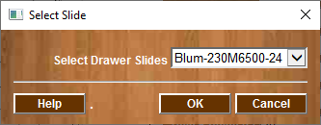
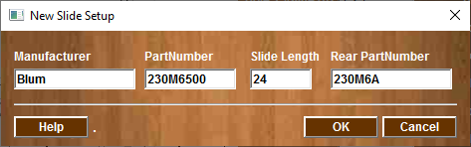
Drawer Slide Setup
Enter Manufacturer Part Number
Enter Rear Mount Part Number for this Slide Model
Enter Manufacturer
Enter Slide Length
Select a Different Drawer Slide
These are Required Values
After adding the Drawer Identification, you will add the dimensional values for both Side and Rear Mount
Selecting Drawer Slide
Adding a New Drawer Slide to the Library

Slide 13
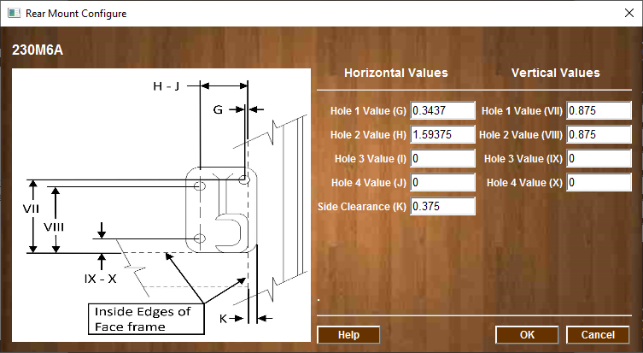
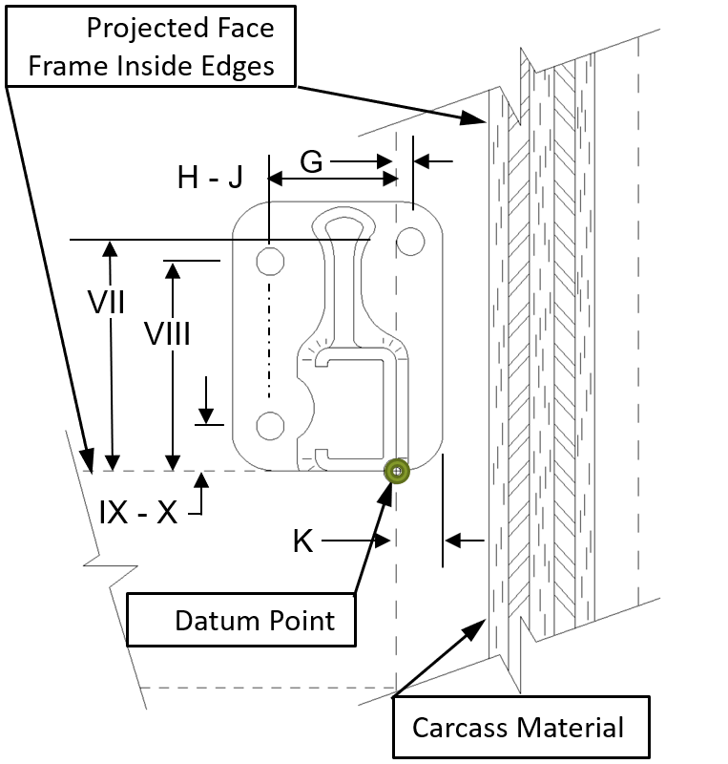
Rear Drawer Slide Mount Menu
Select Different Drawer Slide
Note: Each Hole Must Have Both (H & V) Values
Rear Mount Part Number
Up to 4 Holes
Can Be Enter
Rear Side Clearance Values can be (+ or - )

Slide 14
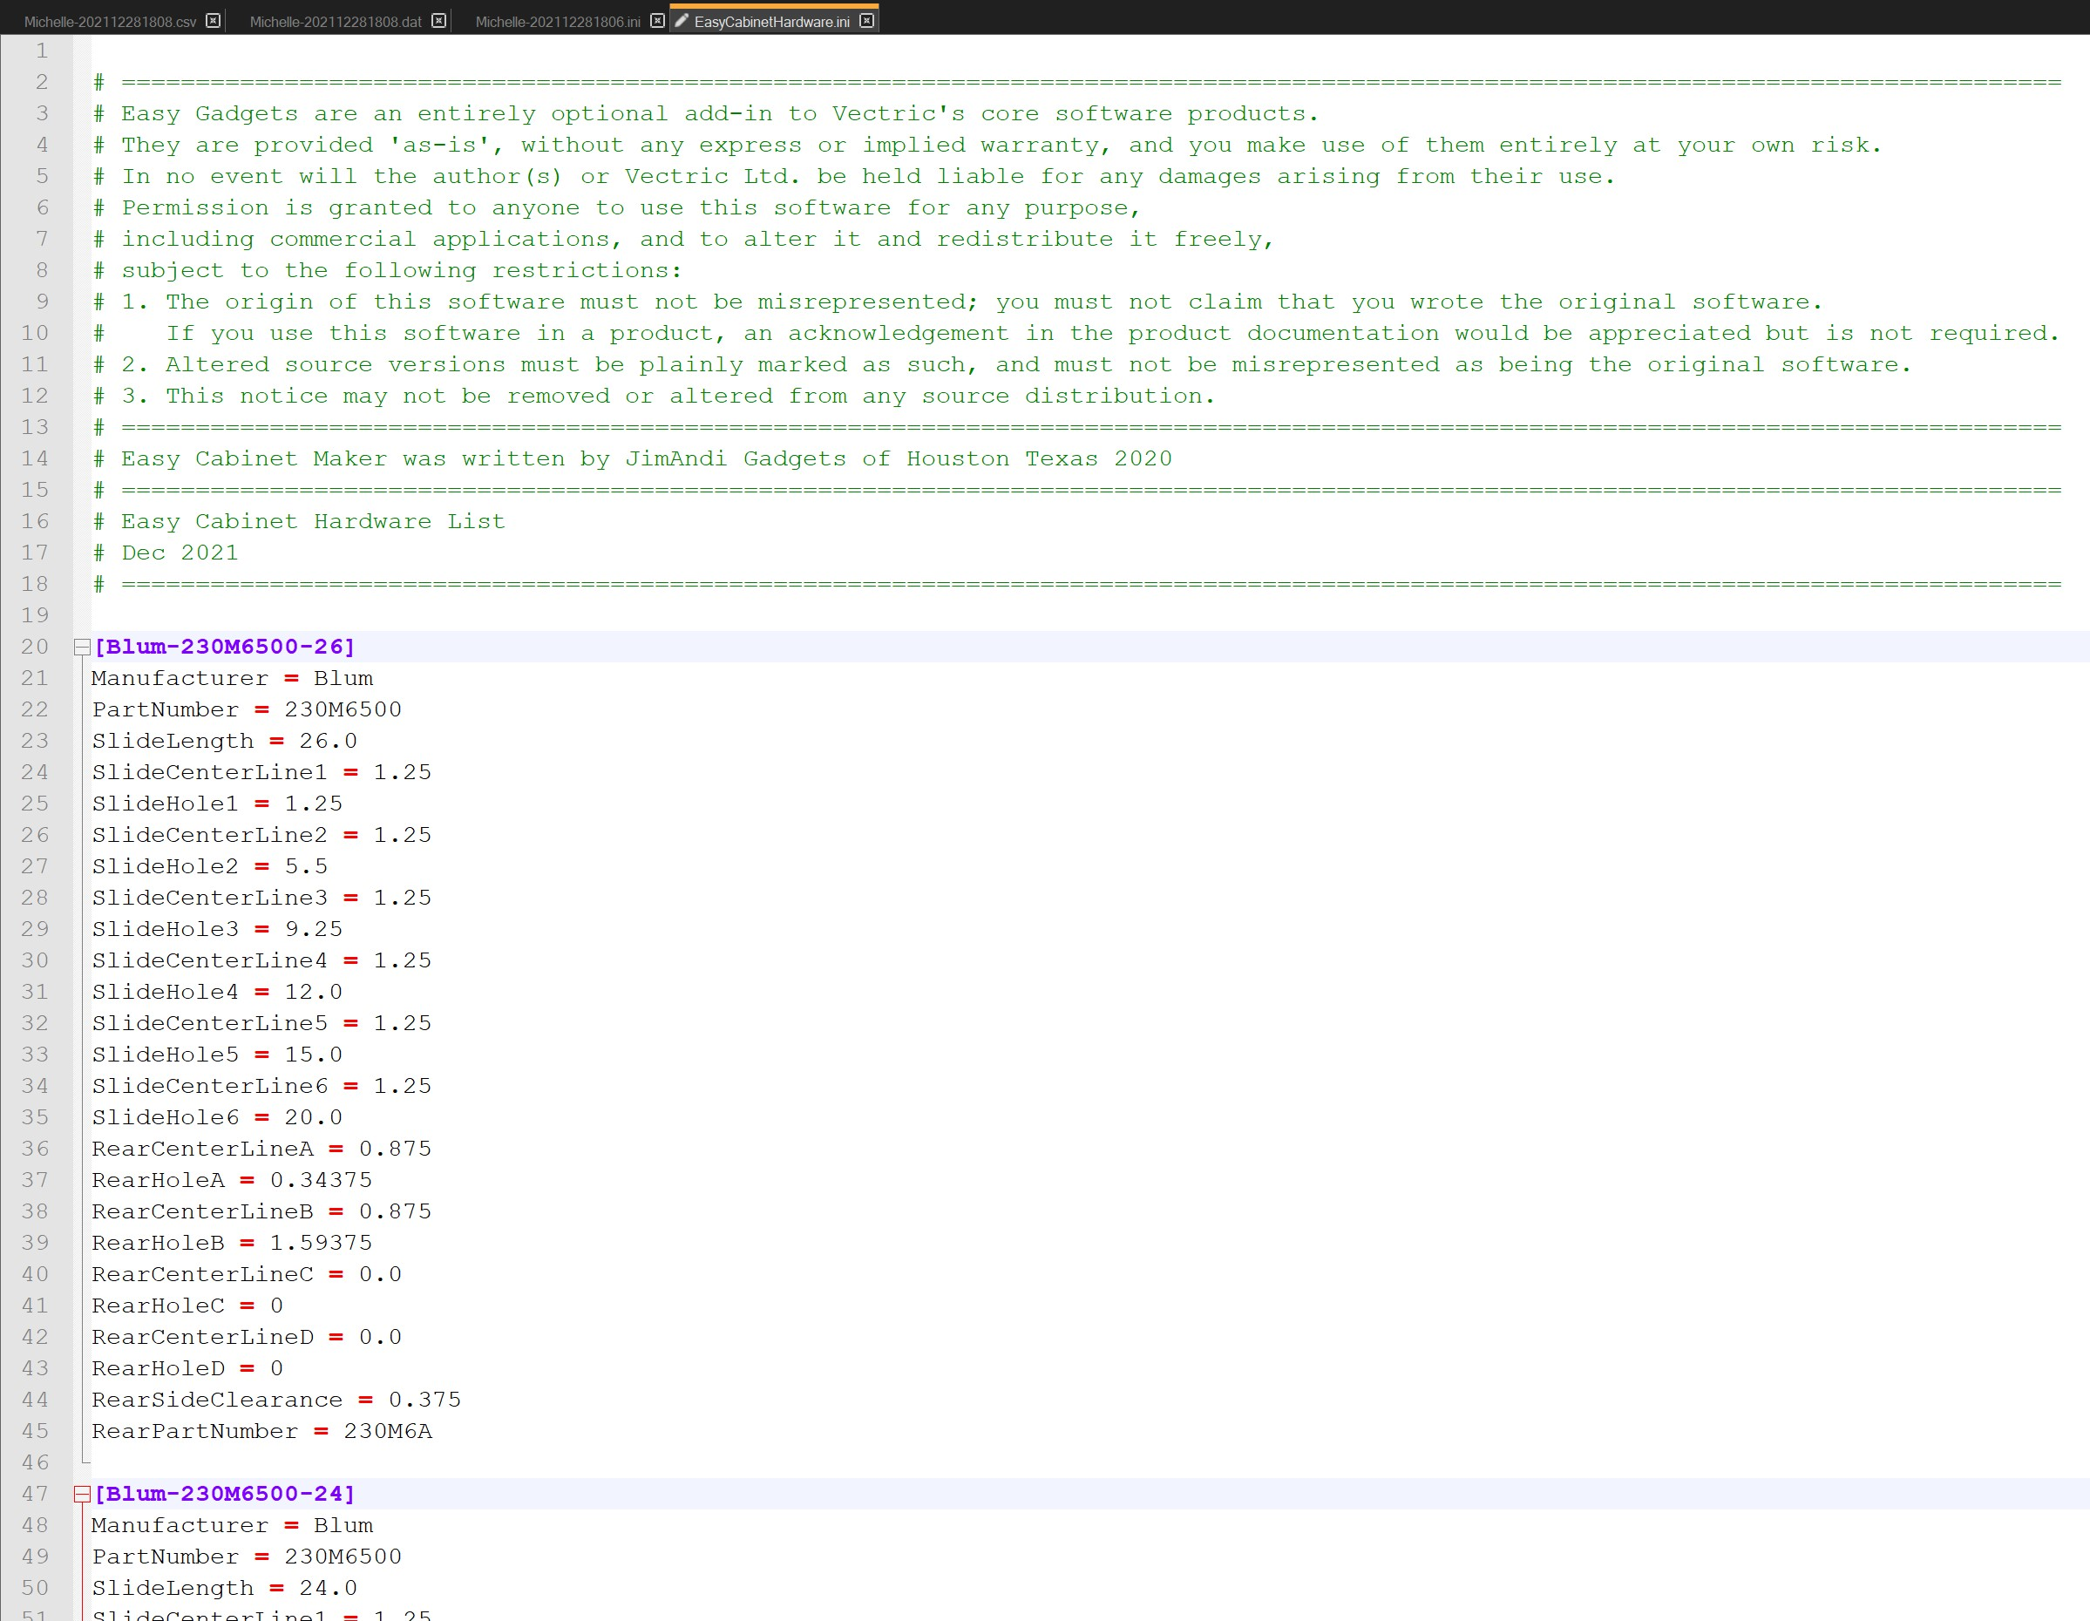
Drawer Slide Data File
Drawer Slide Name
Rear Mount Name

Slide 15
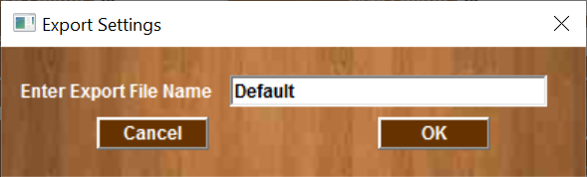
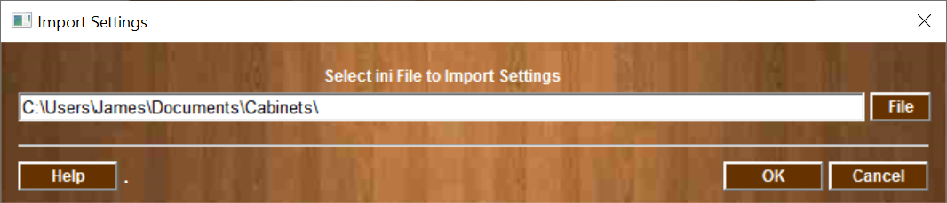
Import & Export Menu Settings
The Import & Export function can allow the user to save all of the cabinet settings to a file and be recalled as needed.
The system will automatically append “-YYYYMMDDHHMM” to the file name to ensure the export file name is unique.
Enter File name for Cabinet Export Settings
Select File Cabinet Settings Import

Slide 16
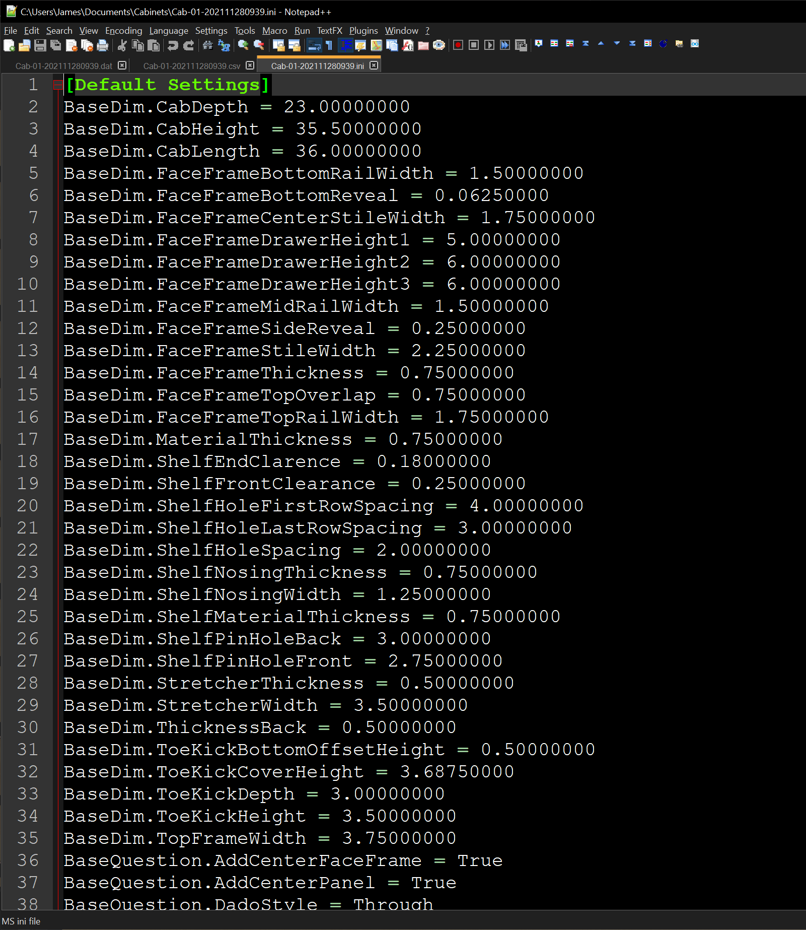
Export & Import File Structure
All of the Gadget data can be exported to a standard “.ini” file. This file is used to Export and Import all of the user inputs for the current cabinet design. This feature allows the user to create a cabinet style and store it based on a project at a later time import the complete cabinet setting for additional cabinet layouts.

Slide 17
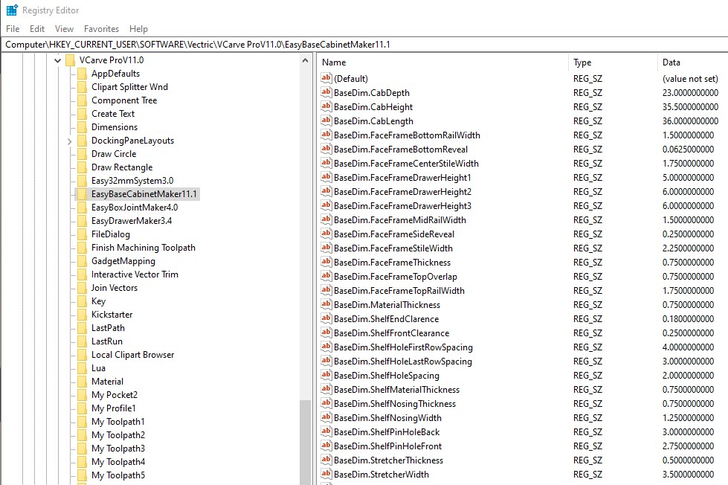
Registry Data - Recalling values across multiple sessions
All data is stored in the system registry and can be accessed using the Microsoft Regedit tool

Slide 18
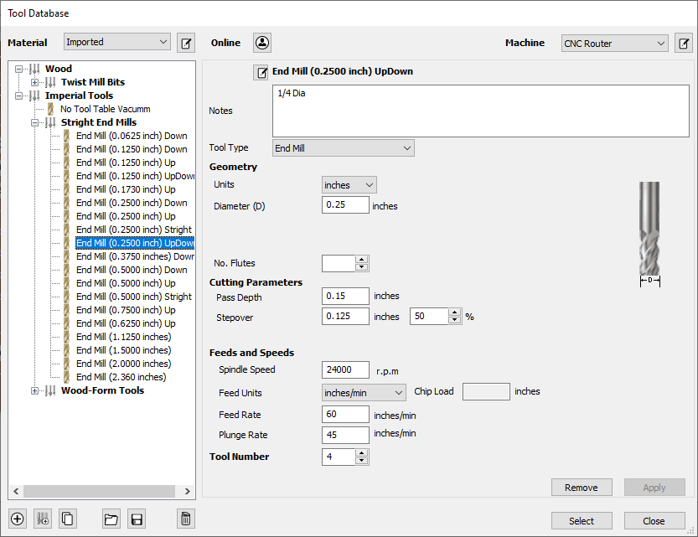
Tool Selection for Part Profile

Slide 19
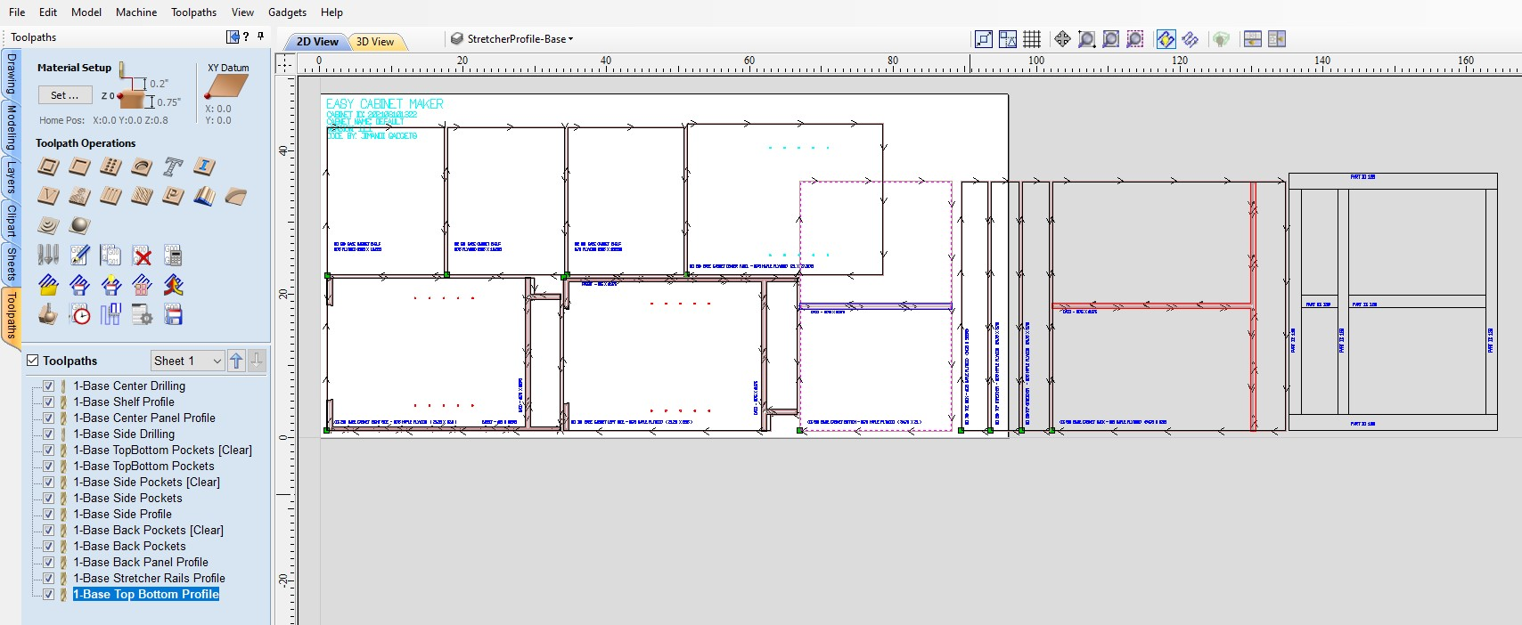
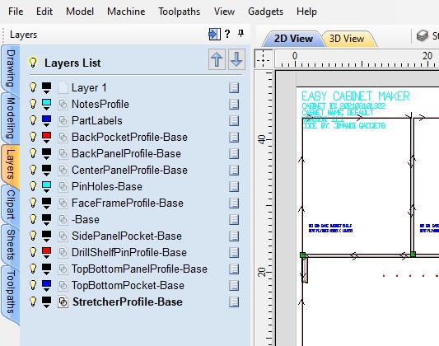
Layers and Toolpaths
All data is stored in the system registry and can be accessed using the Microsoft Regedit tool
Verbose naming for Layer and Toolpaths to assist in identification

Slide 20
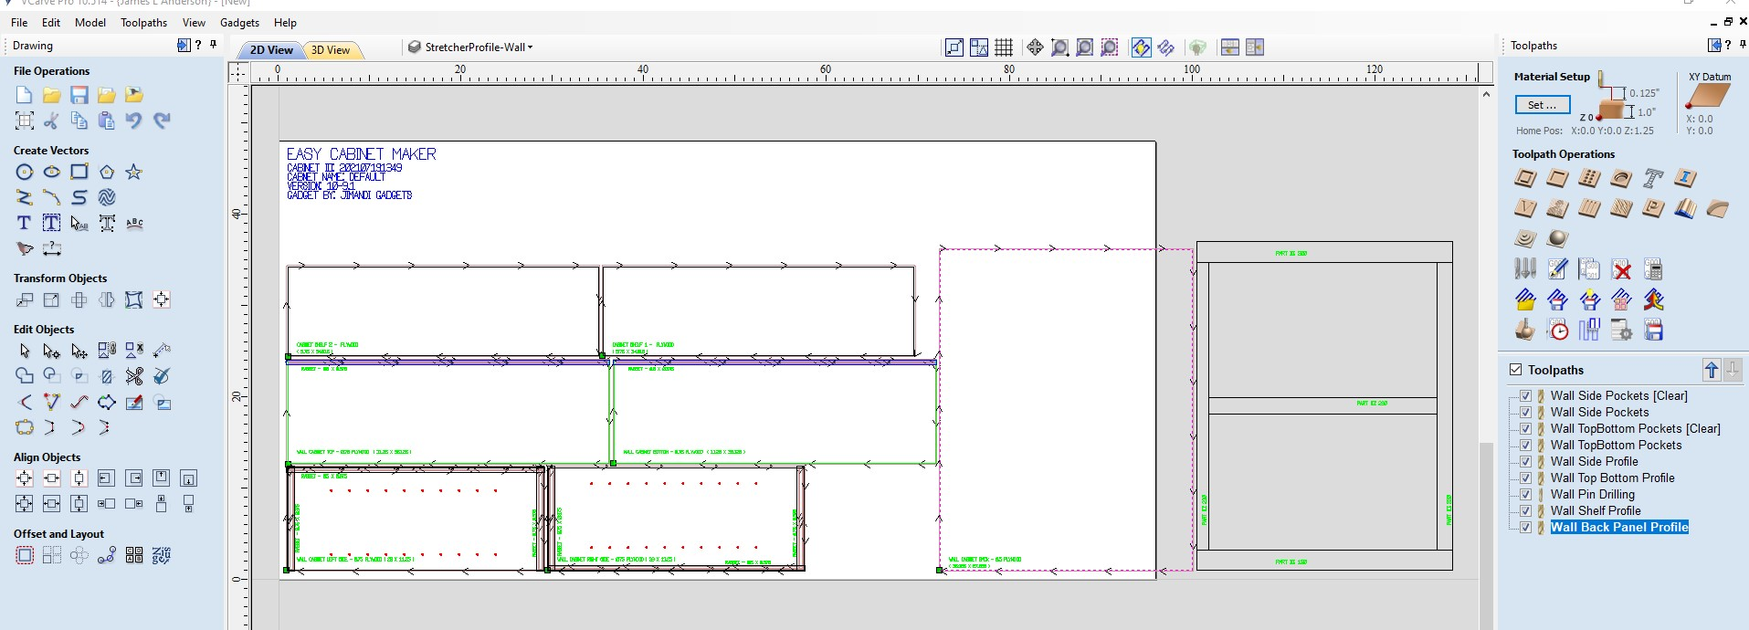
Wall Cabinet Layout

Slide 21
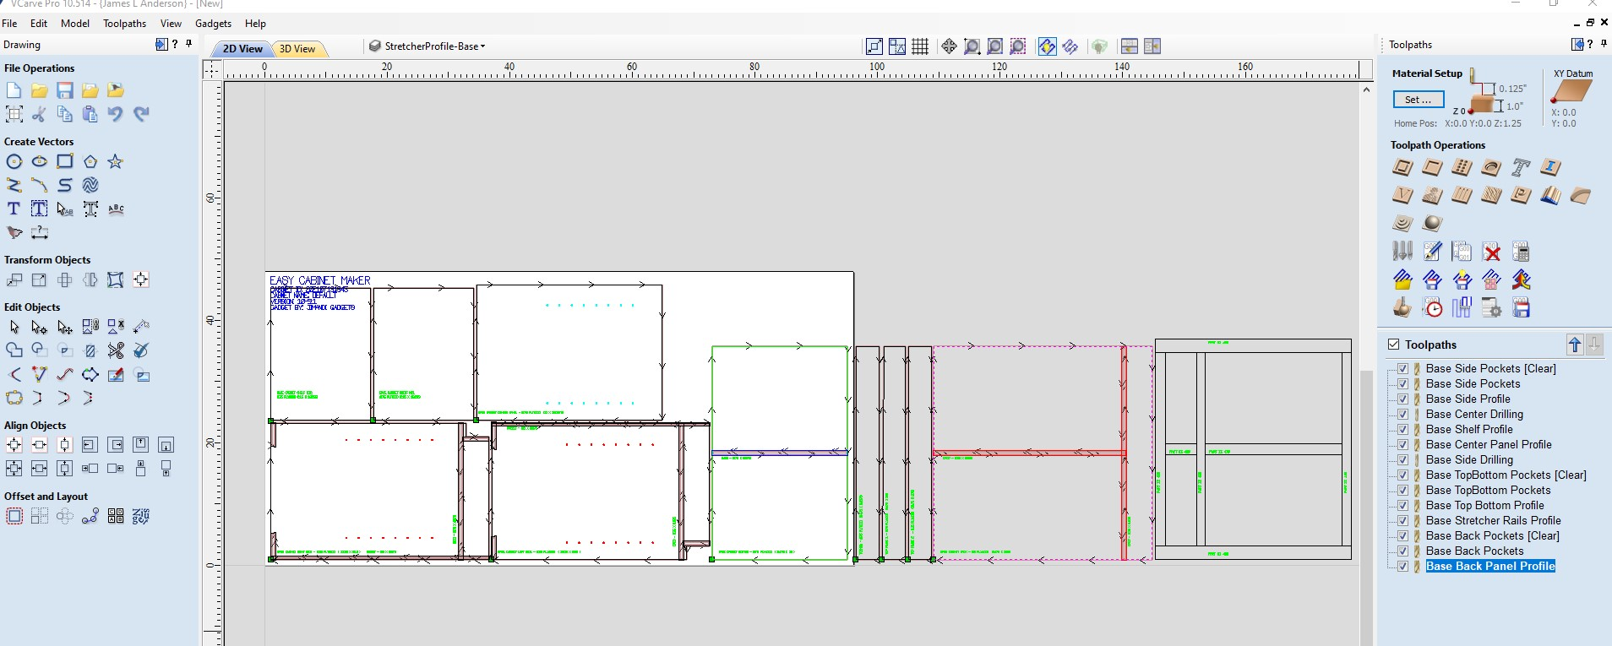
Base Cabinet Layout (With Sheets Off)

Slide 22
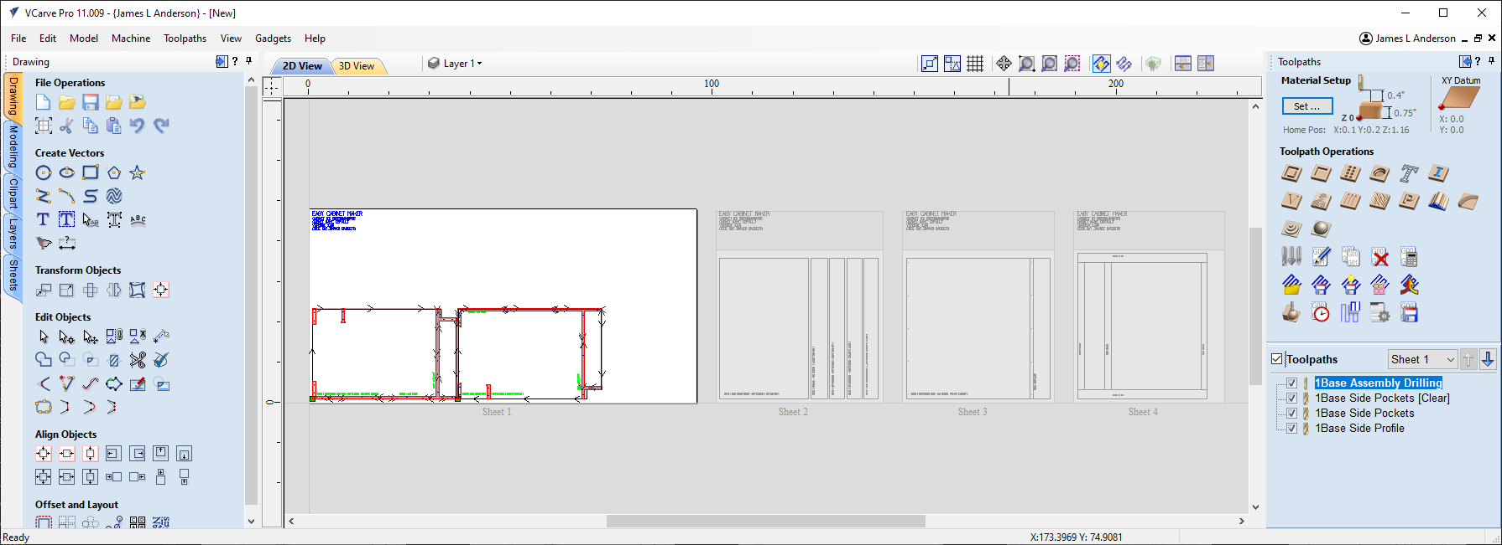
Base Cabinet Layout (With Sheets On)

Slide 23
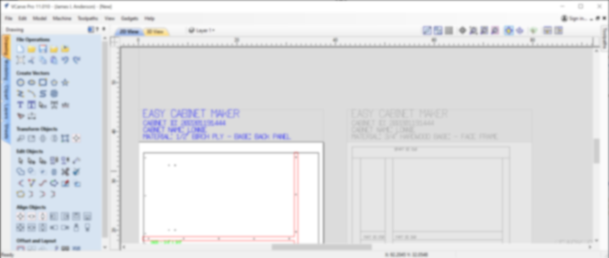
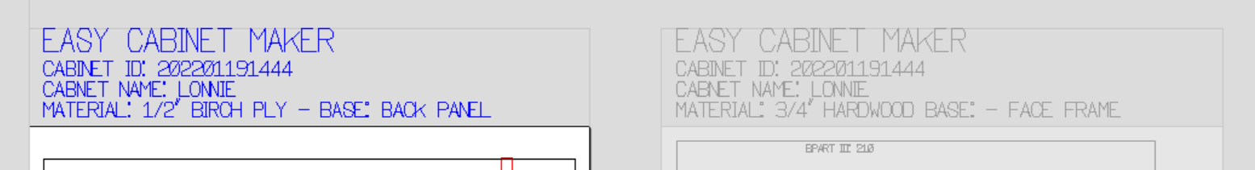
Sheet Labels

Slide 24
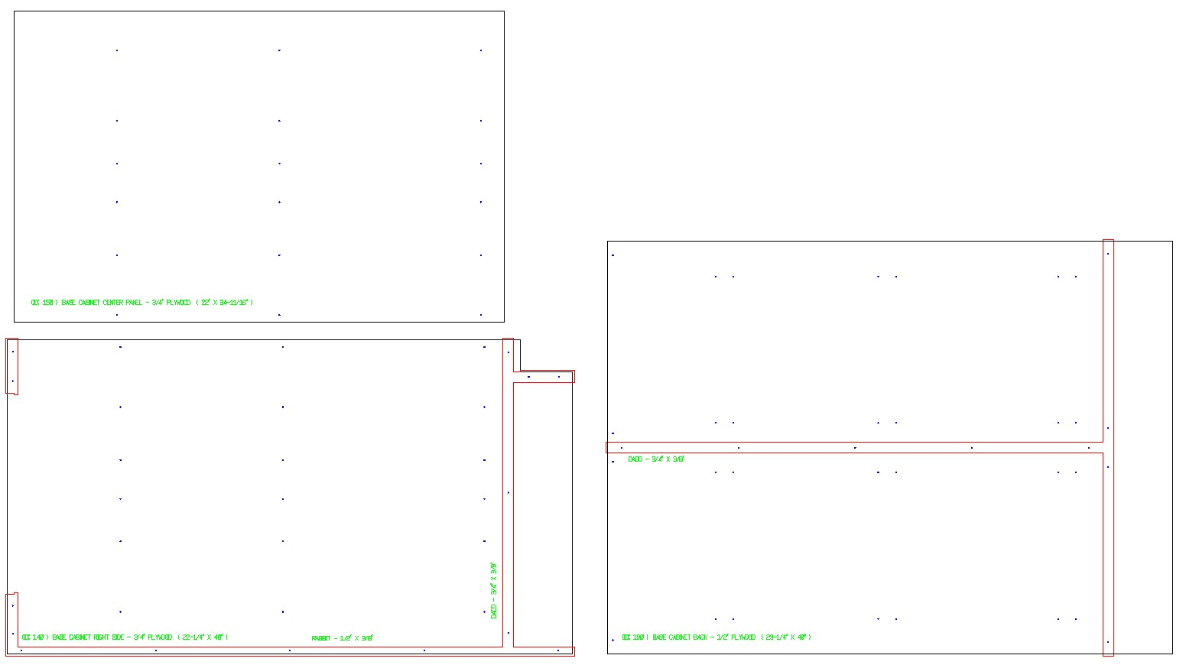
Base Parts – Drawer Slide Pilot Holes
Assembly Holes
Drawer Slide Pilot Holes
Rear Mount Drawer Slide Pilot Holes
Base Center Panel
Base Rear Panel
Base Slide Panel

Slide 25
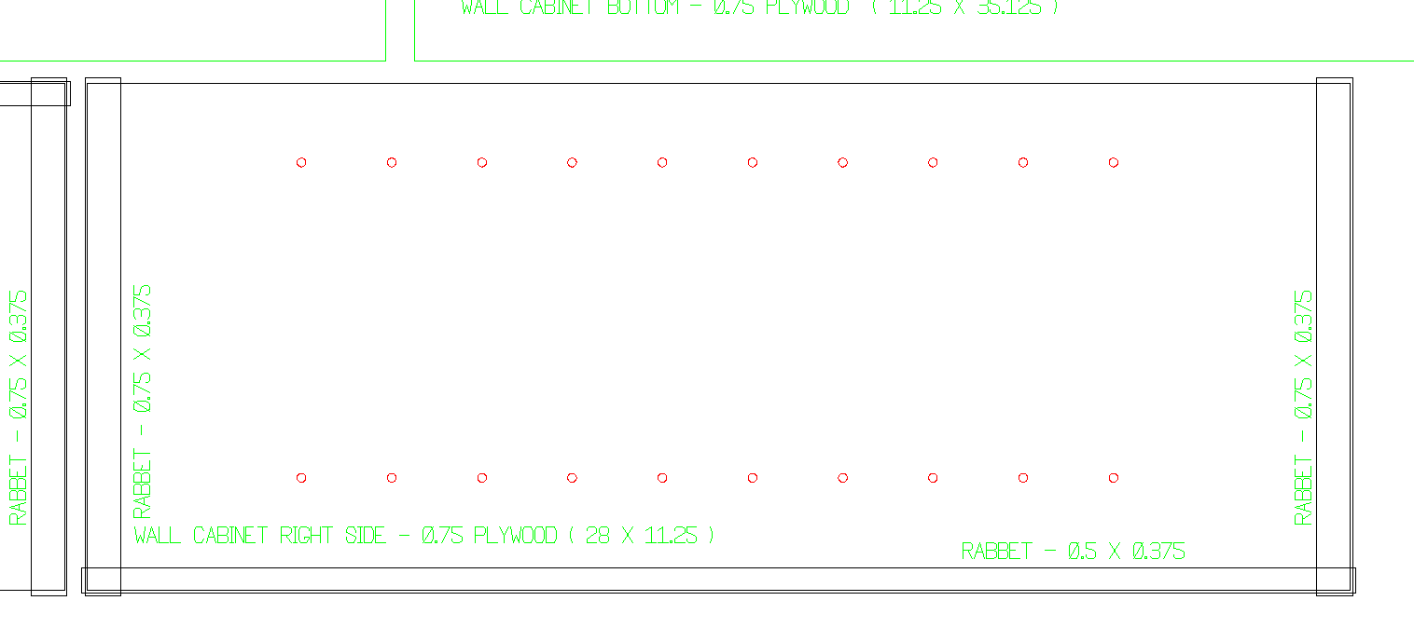
Part Identification and Milling Notation
Each Part is labeled with
Where it is used, Thickness, Length, and Width
Each Milling operation can show labels for the Type, Width and Height (See Milling Setting)

Slide 26
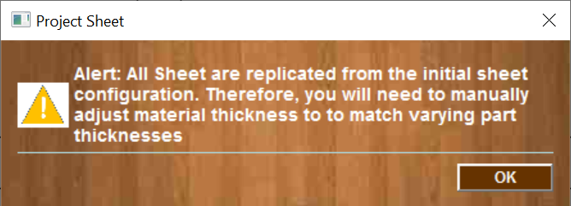
Process Completion

Slide 27
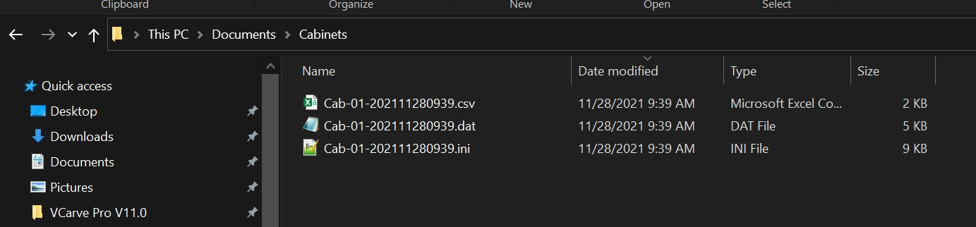
Bill of Material Files
All project files (csv, dat, and ini) are stored in the Project directory

Slide 28
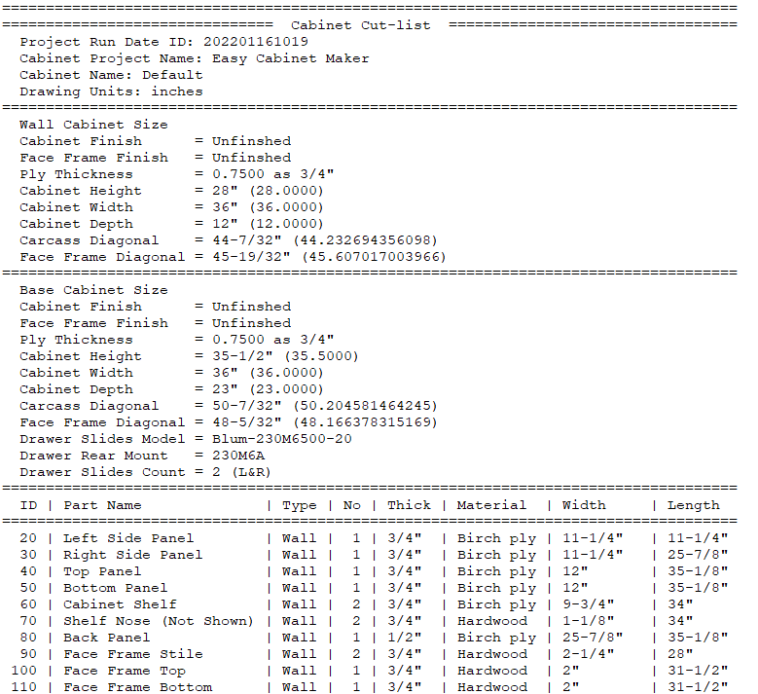
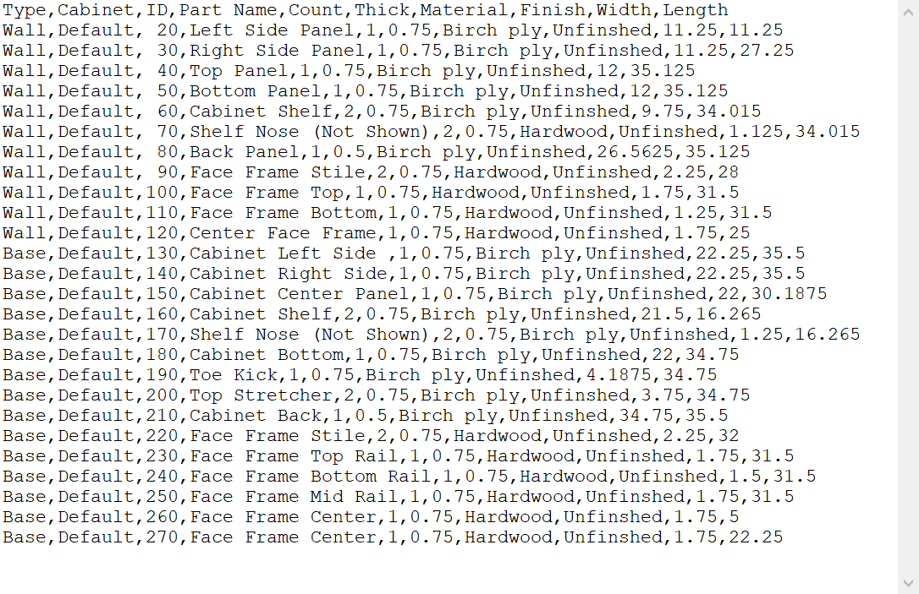
Edit CSV file in Excel or Text editor
Excel ready (.csv) Bill of Materials
Print ready (.dat) Shop Bill of Materials

Slide 29
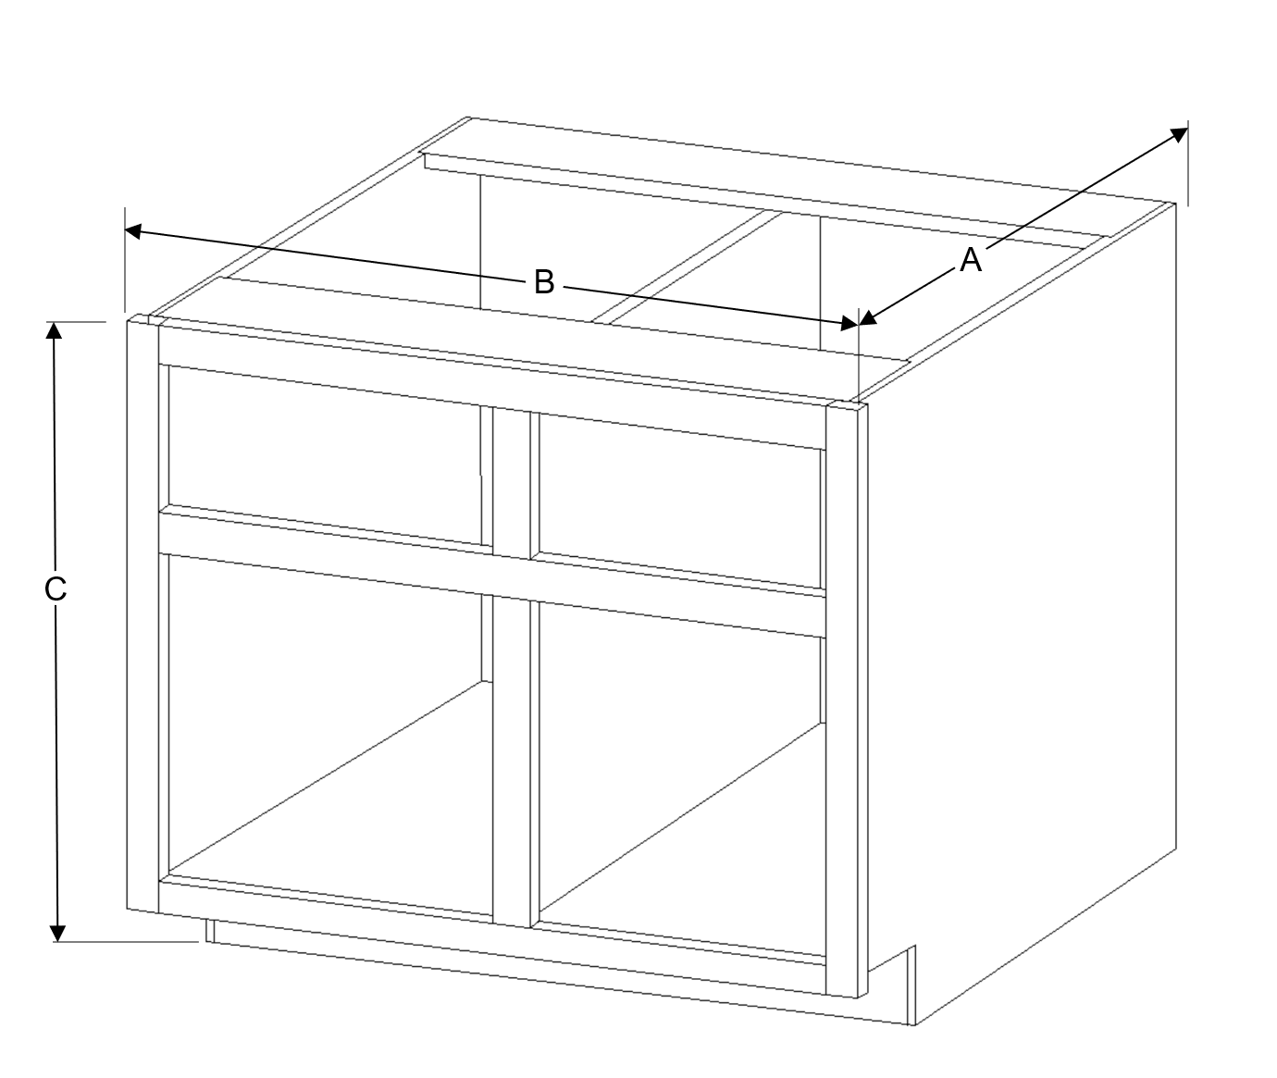
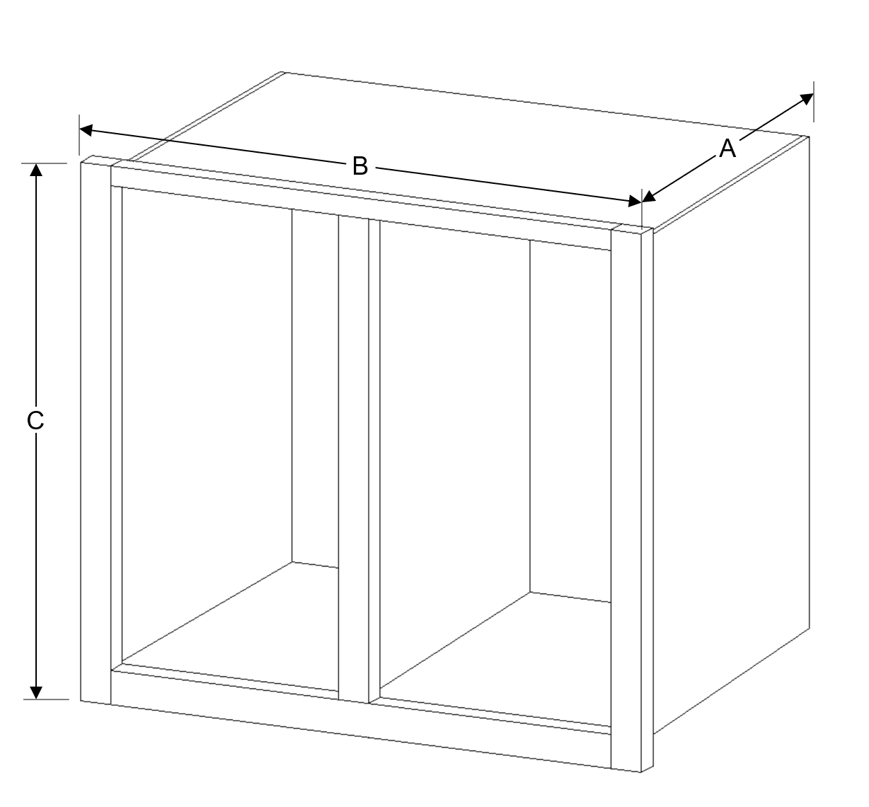
Cabinet Dimensioning
B – Cabinet Length
A – Cabinet Depth
B – Cabinet Length
A – Cabinet Depth
C – Cabinet Height
C – Cabinet Height
Base Cabinet Dimensions
Wall Cabinet Dimensions

Slide 30
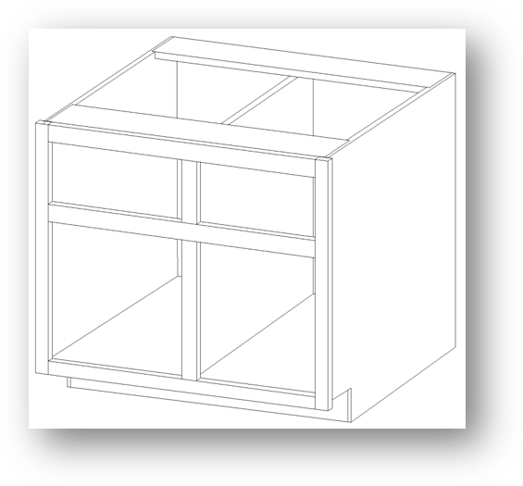
Base Cabinet Sections and Details
.
.
.
.
.
.
.
.
.
.
.
.
.
.
.
.
.
.
.
.
.
.
.
.
.
.

Slide 31
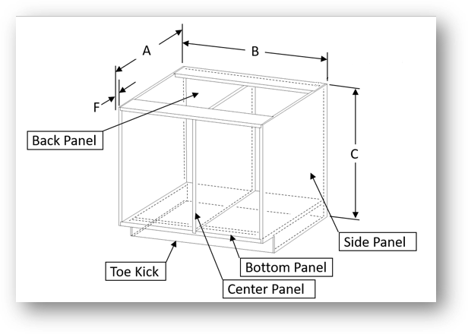
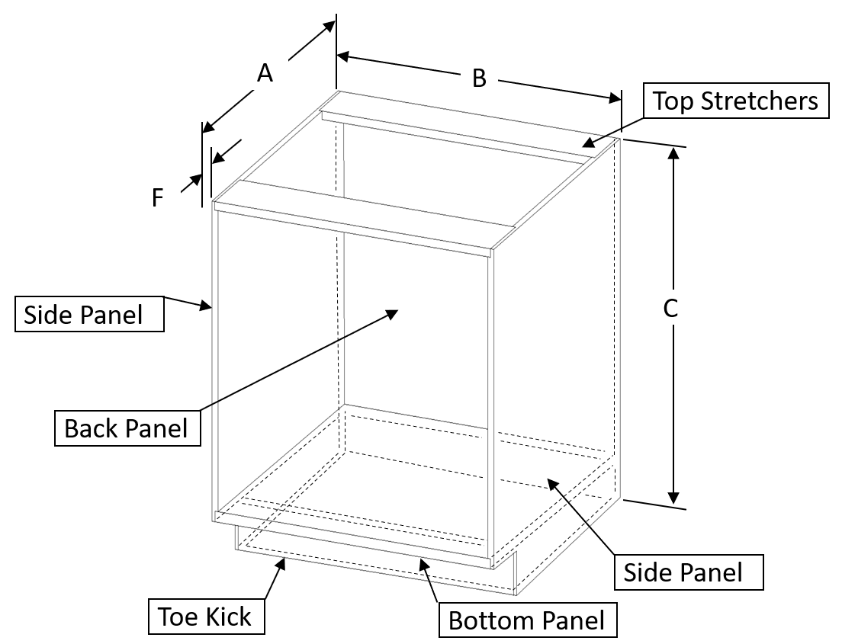
Base Cabinet Carcass with and without Center Panel
X
Y
X
Y
Z
Z
Base Cabinet with Center Panel
Base Cabinet without Center Panel
Note: The face frame is not shown

Slide 32
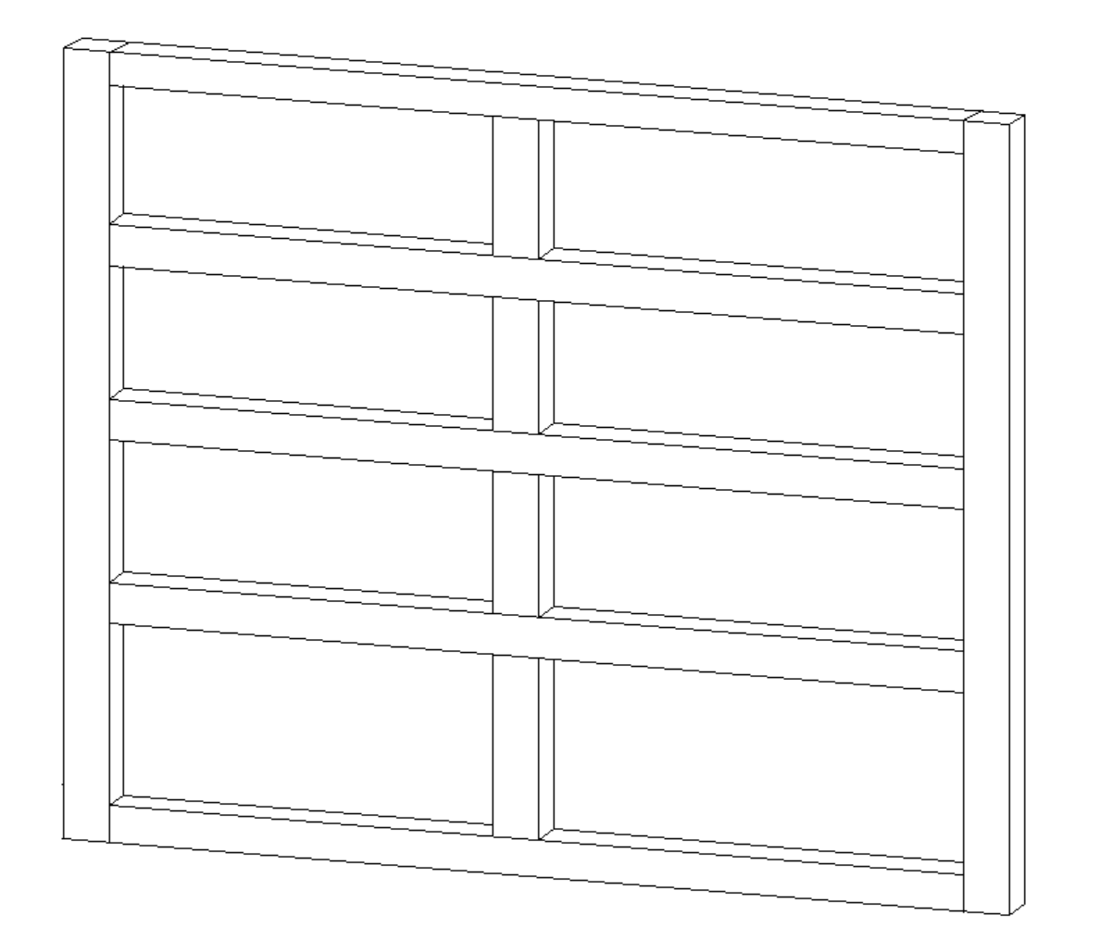
Base Face Frame Part Names
Top Rail
Drawer Height 1
Mid Rail
Drawer Height 2
Stile
Center Stile
Bottom Rail
Drawer Height 4
Base Cabinet Face Frame

Slide 33
Base Cabinet Sections
E
C
.
.
.
.
D
.
.
.
.
.
.
.
.
.
.
.
.
B
F
Base Cabinet Section Cuts

Slide 34
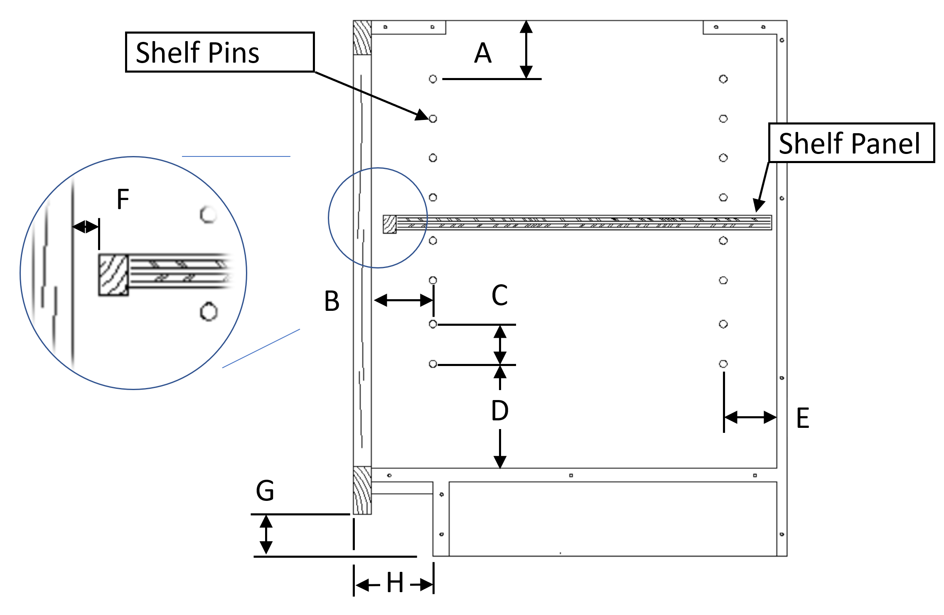
Base Cabinet Side Cross Section Details
A
See Shelf Section
Values
A – Shelf Pin Hole Top Spacing
B – Shelf Pin Hole Front Spacing
C – Shelf Pin Spacing
D - Shelf Pin Hole Bottom Spacing
E - Shelf Pin Hole Rear Spacing
F – Shelf Front Clearance
G – Toe Kick Height
H – Toe Kick Depth
K – Toe Kick Bottom Offset Height
Shelf Section
K
Assy Holes
Base Cabinet Cross Section

Slide 35
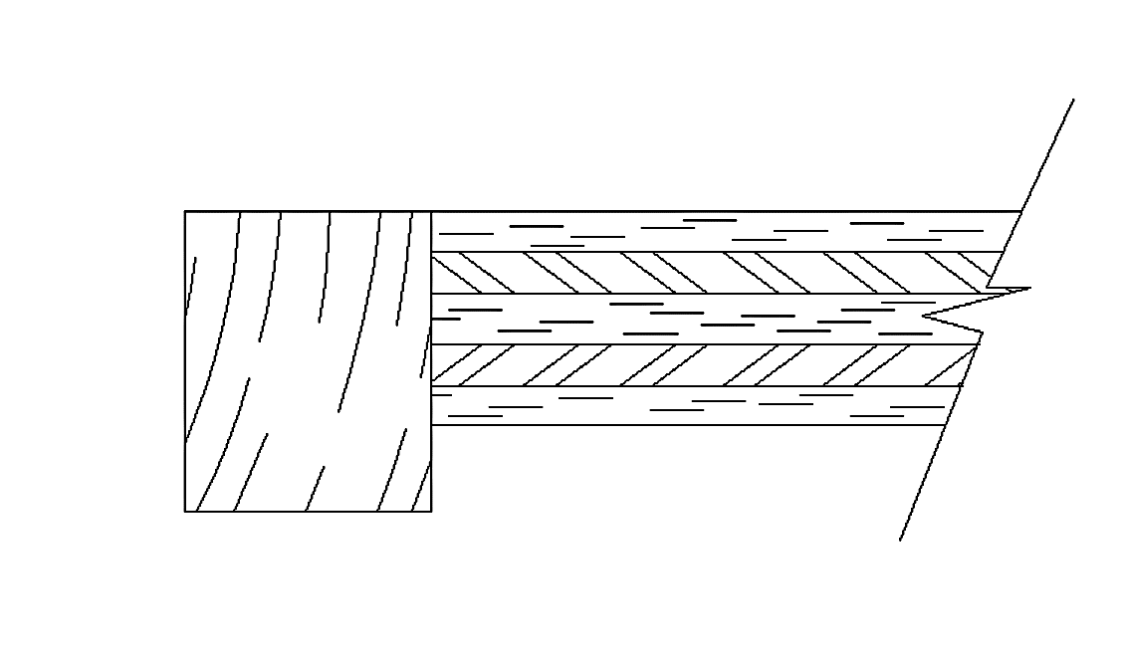
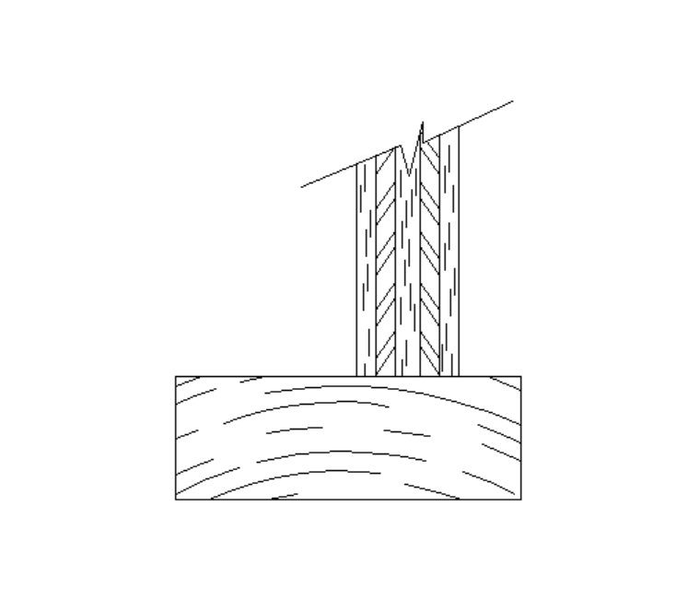
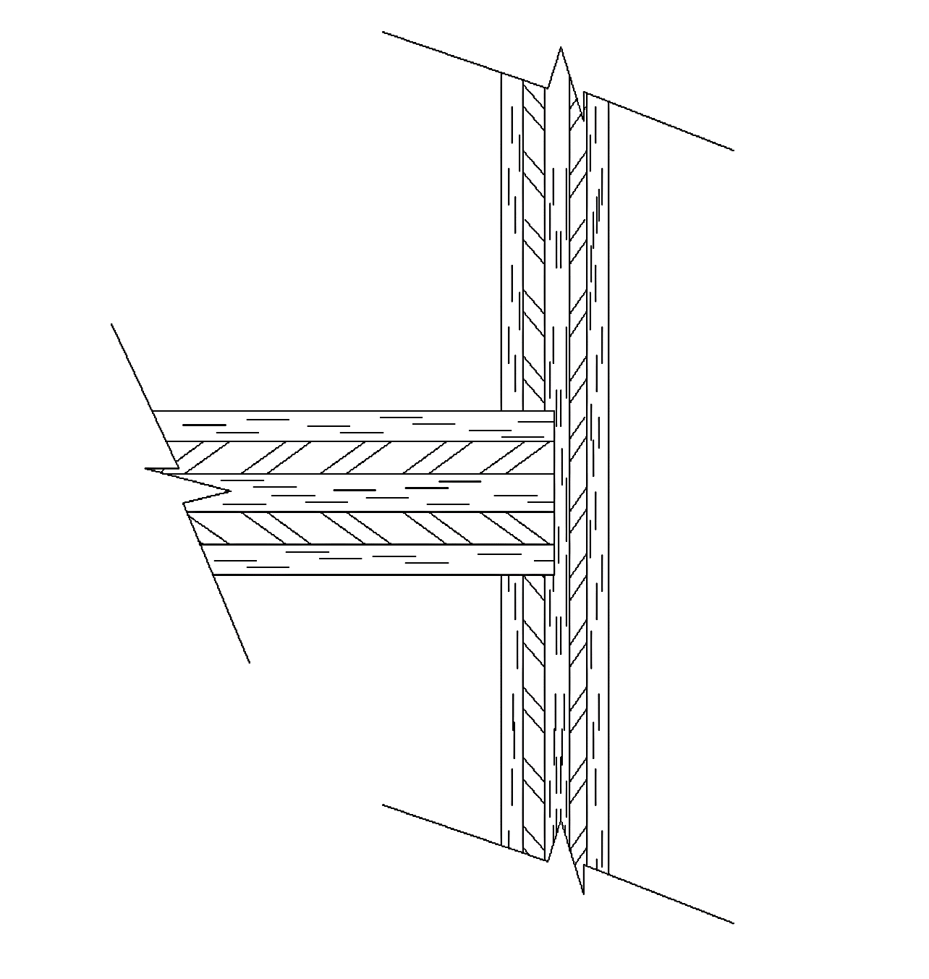
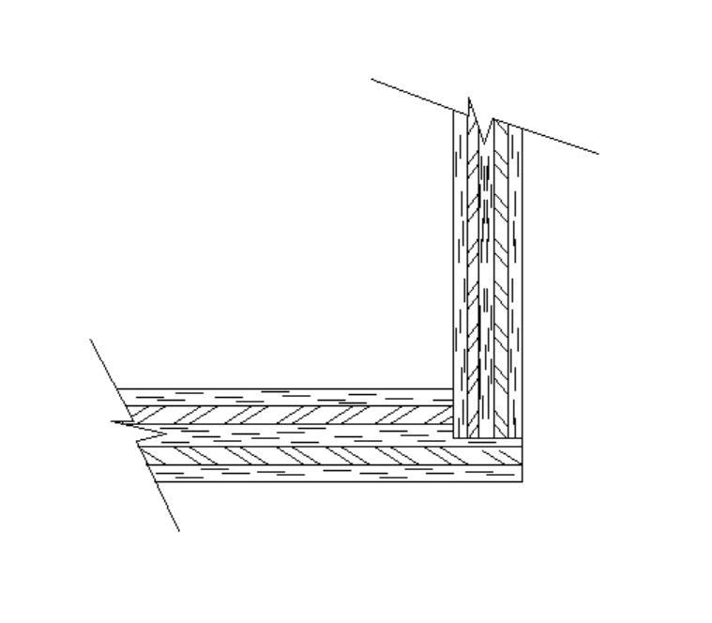
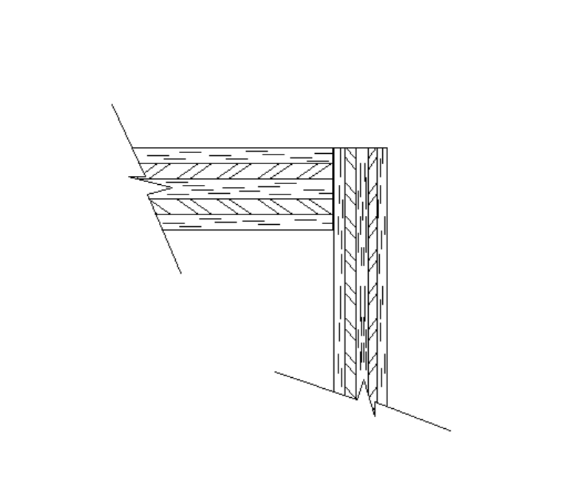
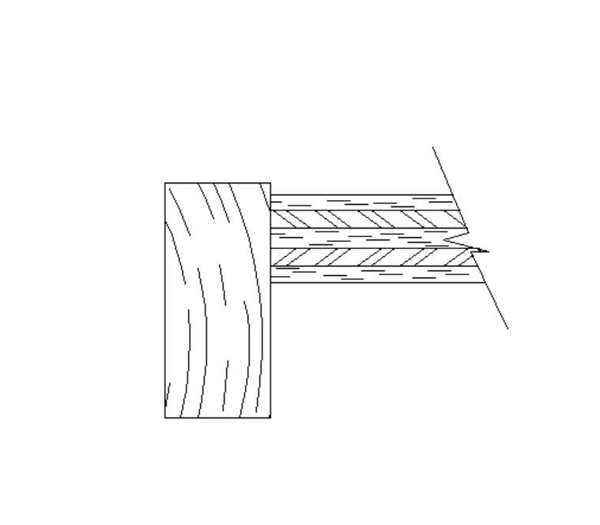
Base Cabinet Part Details
Shelf Nosing
Shelf Panel
Shelf Pin Hole
Bottom Panel
Values
A – Shelf Nosing Width
B – Shelf Nosing Thickness
C – Face Frame Side Reveal
D – Face Frame Thickness
E – Stile Width
F – Back Material Thickness
G - Carcass Thickness
H – Carcass Dado Height
J – Bottom Rail Width
K – Bottom Rail Reveal
L – Back Dado Height
Side Panel
L
A
Stile
C
B
A
Shelf Section
D
G
F
E
Back Panel
B
Stile Section
C
Bottom to Back Section
Back Panel
Top Stretcher
Bottom Rail
Side Panel
K
F
G
J
F
G
H
Back Panel
D
D
E
Top to Back Section
Bottom Rail Section
Side to Back Section
F

Slide 36
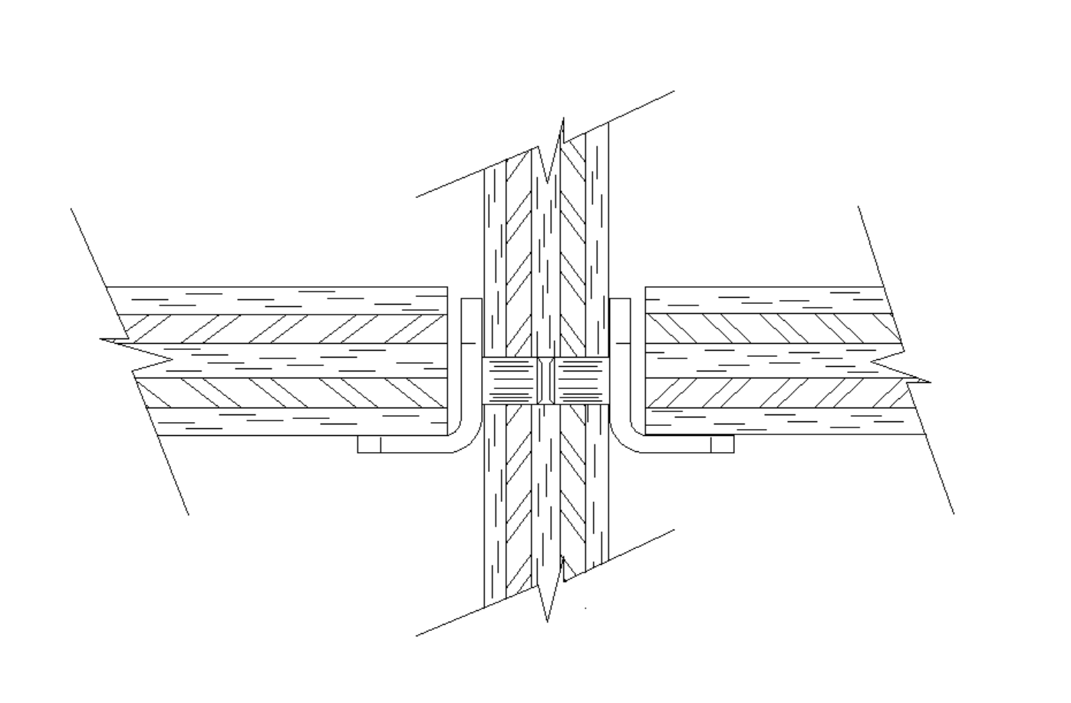


Base Cabinet Shelf Pin Details
Values
A – Shelf Pin Diameter
B – Shelf End Clarence
C – Shelf Pin Depth
Shelf Material
Center Panel Material
B
B
A
Shelf Pin
Shelf Pin
Note: Center Panel Shelf Pen Hole is a through hole
C
Carcass Material
Side Panel Shelf Pin Section
Center Panel Shelf Pin Section
Note: Your Hardware products may very from what is shown. You will need to enter values that support your Cabinet (Pins, Drawer Slides, Rear Mount) Hardware

Slide 37


Base Cabinet Shelf Pin Details
Values
A-F – Side Pilot Horiz Values
I-VII – Side Pilot Vert Values
G-H - Rear Mount Pilot Horiz Values
K – Rear Mount Side Clearance
VII- X – Rear Mount Pilot Vert Values
Horizonal Values
Projected Face Frame Inside Edges
B,C -F
Vertical Values
G
A
H - J
VII
VIII
II - VII
I
IX - X
K
Datum Point
Datum Point
Face Frame Outside Face
Carcass Material
Drawer Slide Pilot Holes – Side View
Rear Mount Pilot Holes – Front View
Note: Your hardware products may very from what is shown. You will need to enter values that support your Cabinet (Pins, Drawer Slides and Rear Mount) Hardware

Slide 38



Base Dado Details
Dado Cut
Values
A – Carcass Thickness
B – Back Material Thickness
C – Carcass Dado Height
D – Back Dado Height
E – Dado Blind Amount
E
A
Carcass Material
Dado Height is measured from the back of the material to the bottom of the dado. This method insurers consistent dimensions regardless of the variations in the thickness of sheet goods.
Half-Blind Dado
B
Carcass Material
Carcass Material
Carcass Material
Back Material
Dado Cut
A
A
C
B
D
A
C
Back Material
Through Dado
Carcass – Back Dado Height

Slide 39

Wall Cabinet Sections and Details
.
.
.
.
.
.
.
.
.
.
.
.
.
.
.
.
.
.
.
.
.
.
.
.
.
.
.
.

Slide 40


Wall Cabinet Carcass with and without Center Panel
X
Y
X
Y
Z
Z
Wall Cabinet with Center Panel
Wall Cabinet without Center Panel
Note: The face frame is not shown

Slide 41

Wall Face Frame Part Names
Top
Rail
Stile
Bottom Rail
Center Stile
Wall Cabinet Face Frame

Slide 42

Wall Cabinet Sections
E
A
.
.
.
.
.
.
.
.
.
.
.
.
.
.
.
.
.
.
.
.
.
.
.
.
.
.
.
.
C
D
B
F
Wall Cabinet

Slide 43


Wall Cabinet Side Cross Section Details
A
See Top Rail Section
Shelf Pin Holes
Face Frame
A
F
See Shelf Section
Shelf Section
C
F
B
Values
A – Shelf Pin Hole Top Spacing
B – Shelf Pin Hole Front Spacing
C – Shelf Pin Spacing
D - Shelf Pin Hole Bottom Spacing
E - Shelf Pin Hole Rear Spacing
F – Shelf Front Clearance
E
Shelf Section
D
Assy Holes
G
See Bottom Rail Section
Side Panel
Wall Cabinet Cross Section

Slide 44

Wall Cabinet Part Details
Shelf Pin Hole
Center Panel
Values
A – Shelf Nosing Width
B – Shelf Nosing Thickness
C – Face Frame Side Reveal
D – Face Frame Thickness
E – Stile Width
F – Top Rail Width
G – Top Side Reveal
H – Back Material Thickness
J - Carcass Thickness
K – Carcass Dado Height
L – Bottom Rail Width
M – Bottom Rail Reveal
N – Back Dado Height
Top Panel
Side Panel
Stile
N
F
C
D
J
D
G
Inside
H
E
A
Wall Top Rail Section
B
Stile Section
Back Panel
C
Center to Back Section
K
Back Panel
Bottom Rail
Side Panel
M
H
J
Shelf Nosing
Shelf Panel
Top or Bottom Panel
H
L
A
Back Panel
J
K
D
B
G
D
E
Top-Bottom Back Section
F
Shelf Section
Side to Back Section
Bottom Rail Section

Slide 45


Wall Cabinet Shelf Pin Details
Values
A – Shelf Pin Diameter
B – Shelf End Clarence
C – Shelf Pin Depth
Shelf Material
Center Panel Material
B
B
A
Shelf Pin
Shelf Pin
Note: Center Panel Shelf Pen Hole is a through hole
C
Carcass Material
Side Panel Shelf Pin Section
Center Panel Shelf Pin Section

Slide 46
Wall Dado Details
Dado Cut
Values
A – Carcass Thickness
B – Back Material Thickness
C – Carcass Dado Height
D – Back Dado Height
E – Dado Blind Amount
E
A
Carcass Material
Dado Height is measured from the back of the material to the bottom of the dado. This method insurers consistent dimensions regardless of the variations in the thickness of sheet goods.
Half-Blind Dado
B
Carcass Material
Carcass Material
Carcass Material
Back Material
Dado Cut
A
A
C
B
D
A
C
Back Material
Through Dado
Carcass – Back Dado Height

Slide 47
The End

